Slide 1
Introductory Statistics with R/Python
Part 3: Logistic Regression, Cross-Validation & Practice

Slide 2
Logistic Regression

Slide 3
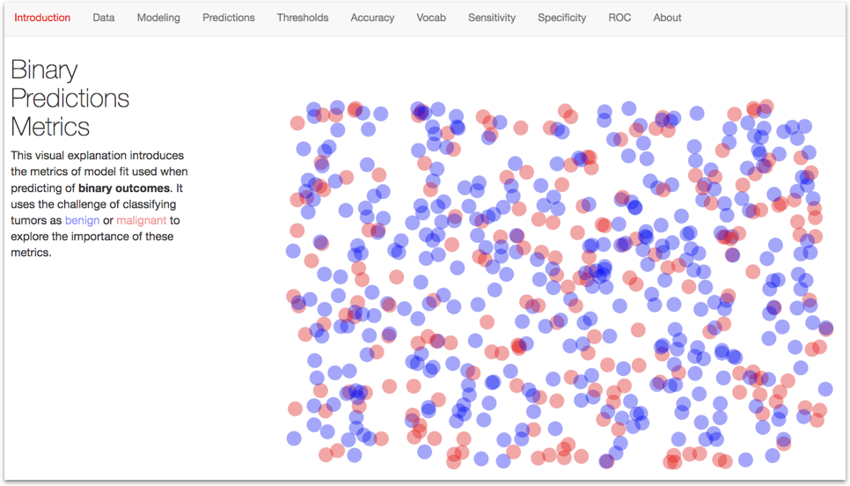
Try this out!

Slide 4
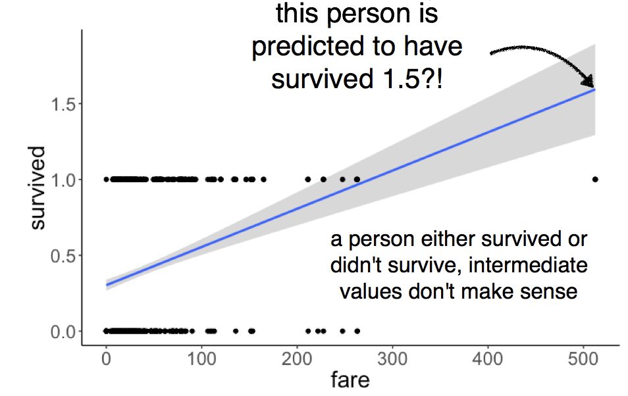
Is there a relationship between fare paid and survival on the Titanic?

Slide 5
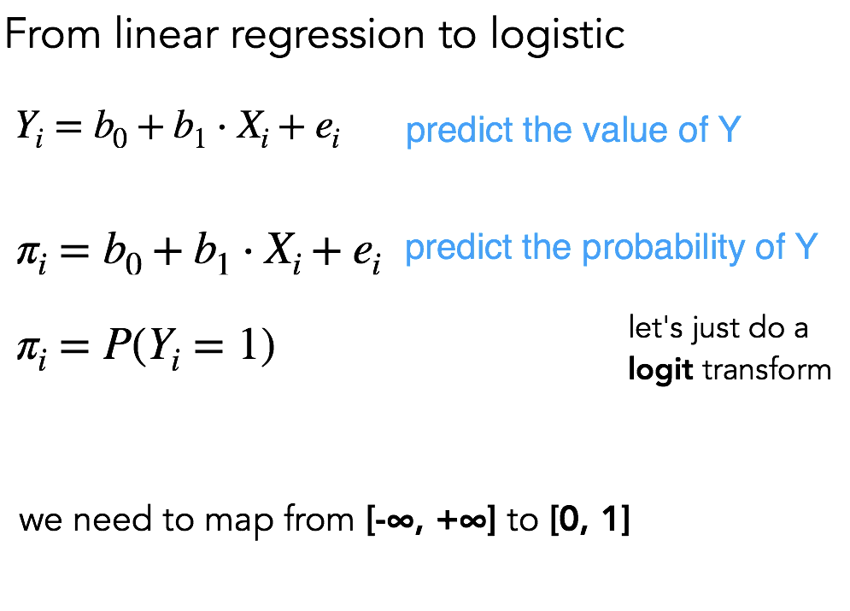

Slide 6
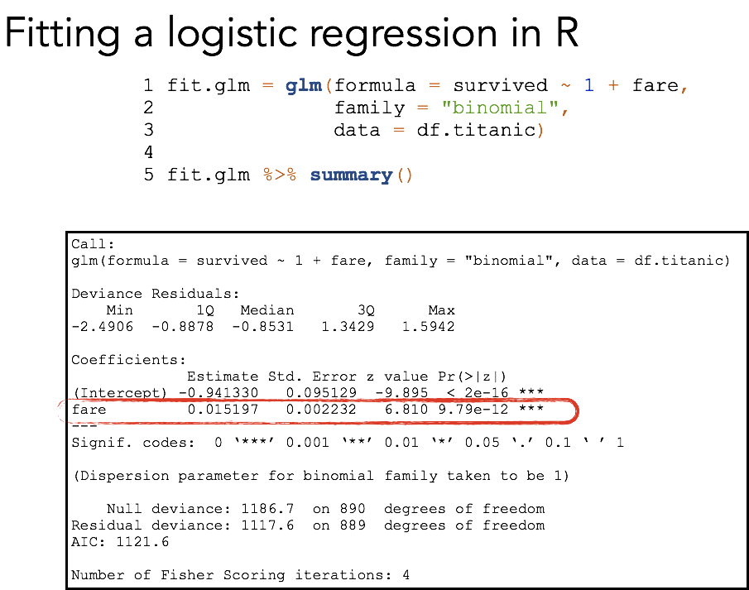

Slide 7
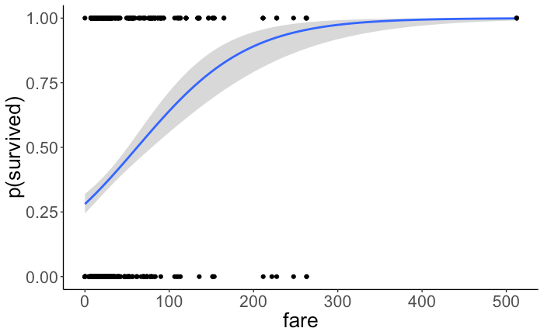

Slide 8
Prediction

Slide 9

Can we predict the future using models?
Once we’ve built a model (e.g., a logistic regression), can we use it to predict outcomes on “unseen” data?
To find out, let’s split our dataset into two subsets: train and test.
Q) Is this possible? If so, what are some methods for doing so?
As an example to think about, suppose we collect brain imaging, genetics, self-report questions, etc. on a group of young individuals, and some of them go on to later develop Major Depressive Disorder (MDD) as adults. Can we use the information we collected when they were young to predict who will develop MDD?

Slide 10
Can we predict the future using models?
Once we’ve built a model (e.g., a logistic regression), can we use it to predict outcomes on “unseen” data?
To find out, let’s split our dataset into two subsets: train and test.
Dataset
Training Set
Test Set

Slide 11
This is called the “hold-out” method.
Use this to test whether the model can predict the outcome variable with data it’s never seen before. Don’t touch this until the very end.
Use this to build (“train”) the model, just like before.
Dataset
Training Set
Test Set

Slide 12
An extension: K-Fold Cross-Validation
Test Set
Fold 1
Test Set
Fold 2
Test Set
...
Test Set
...
Test Set
Fold K
Find average performance on test set over multiple folds.

Slide 13

Try it yourself!
Can we use age and optimism to predict party affiliation?

Slide 14
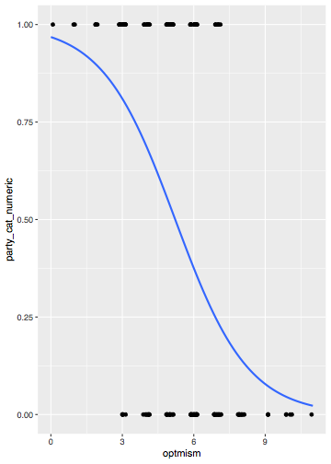
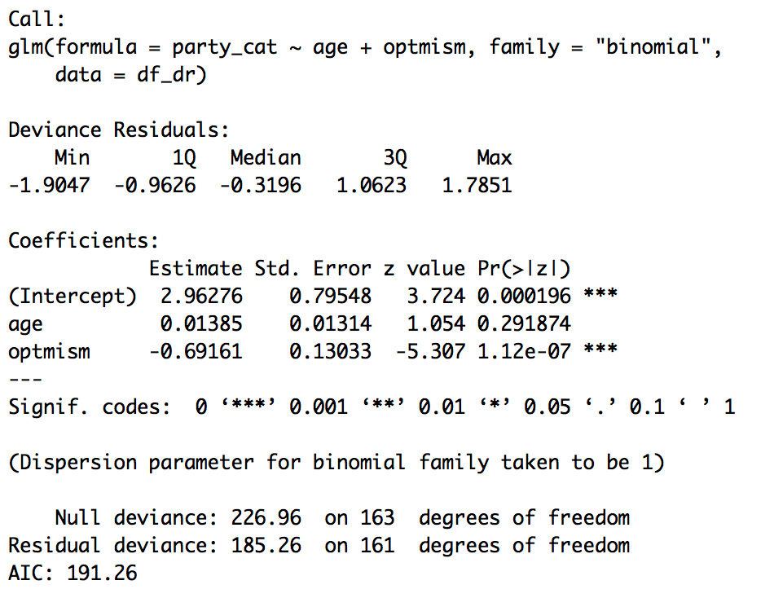
What did you find?

Slide 15
Practice: Stroop Dataset

Slide 16
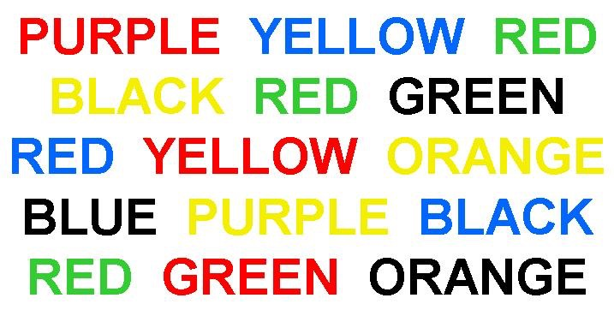
The Stroop Task
Try to say the font color of each word (not the semantic meaning!)

Slide 17
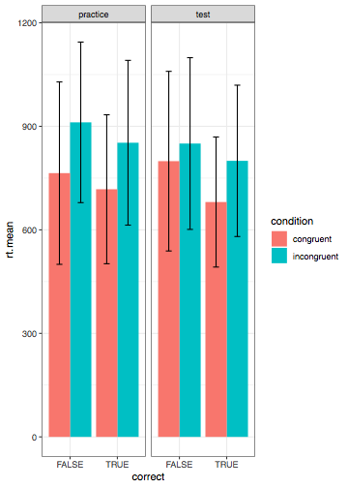

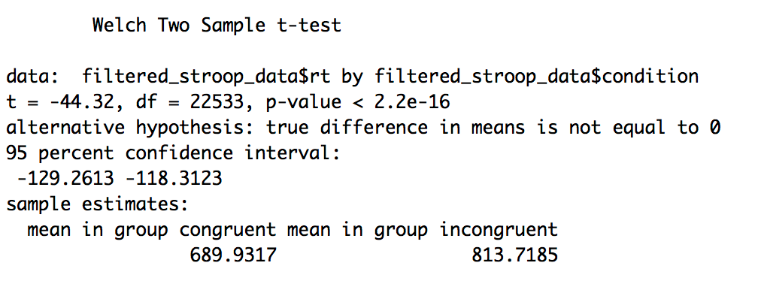

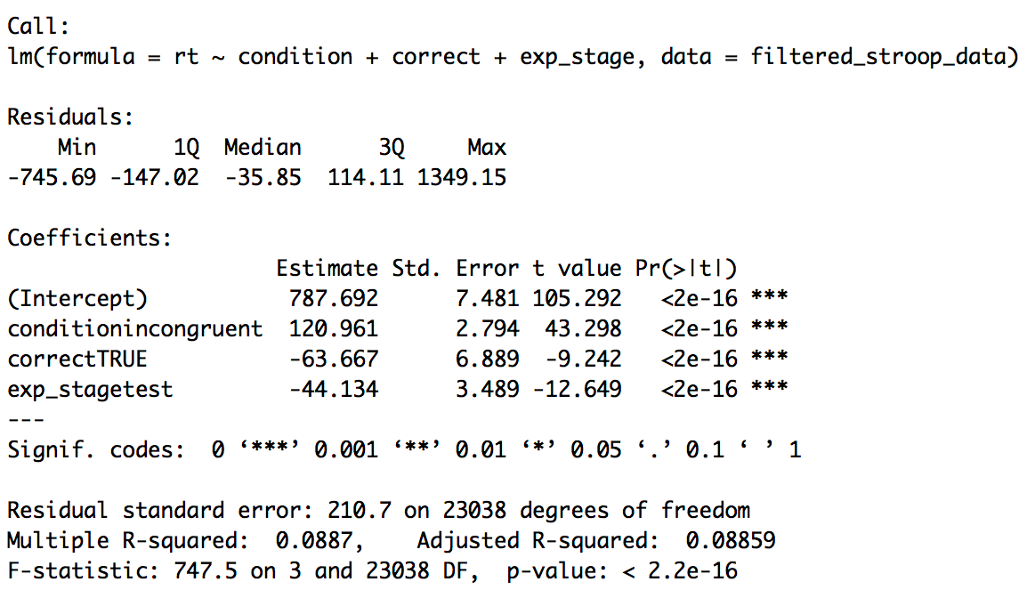

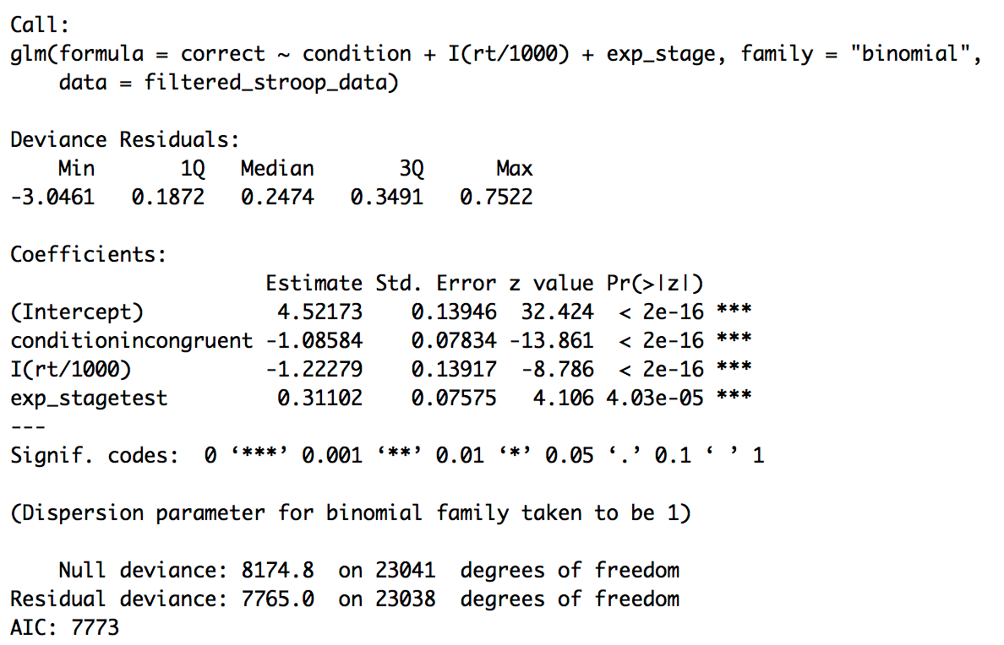
What did you find?

